Slide 1
College of Emerging Technology
Visualizing Highly Connected Data
DRAFT version 0.01 updated Jan 16th, 2019
Notes:
Welcome to this Optum Tech University course on Emerging Technologies. This course is about the visualization and manipulation of highly connected data.

Slide 2
Course Description
This class will help students understand the processes involved in creating and evaluating user interfaces for highly connected data sets as are typically found in in graph databases
The course format is a ½ day (4 hour) instructor-led course
We will review many highly-connected use cases within Optum and their related visualization challenges
Users should have access to the Optum intranet:
http://graph.optum.com
Notes:
This is a bri

Slide 3
Prerequisites
Introduction to Graph Databases
1-hour self-paced
LearnSource
HAS_PREREQUSITE
HAS_PREREQUSITE
HAS_PREREQUSITE
HAS_PREREQUSITE
Graph Modeling
Concept
Graphs
Visualizing
Highly
Connected Data
Graph Algorithms
Instructor led
½ day courses
Notes:
This course assumes that everyone has taken as passed the one hour “Introduction to Graph Databases” class on LearnSource. Students should have a strong understanding of graph data models and be familiar with terms such as vertex, edge and properties. For example, can you identify each of these in the diagram above?

Slide 4
Learning Objectives
Understand how to help users visualize and manipulate highly connected data as is commonly stored in a graph database
Understand how graph visualizations are similar to, but different from visualization of flat or aggregated (OLAP) data and tabular reporting
Review key use-cases and examples of visualizations done within Optum
Notes:
Here are some of the goals of this class.

Slide 5
Why Is this Relevent Now?
Past
Future
Data silos for claims, providers, members, knowledge
Batch claims adjudication
Batch analytics
Monthly reporting cycles
Highly integrated healthcare knowledge graphs
Real-time point-of care decision support
Direct integration into the EMR
Focus on cost savings and

Slide 6
Key Optum Use Cases
Payment integrity and fraud detection
Clinical care paths
Member journey
Human capital social graphs
Strategy graphs and systems dependency analysis
Concept and terminology graphs (medical language)
Workflows and task dependency
Entity resolution – master data management

Slide 7
Why a separate course? Why now?
More Data, More Clinical Data
Clinical data has both complexity and high variability
Graph Databases have matured
Distributed
Secure
Large library of graph algorithms
More rules to connect data (Optum Filament)
AI and Machine Learning Graph technologies are rapidly maturing

Slide 8
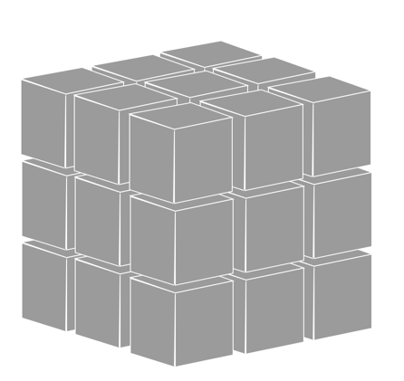
Cubes vs. Graphs
Patient
Time
Condition
Traditional Analytics “Cube”
Uniform Structure
Standardized “dimensions”
Highly Connected Graph
High variability structure
Open world assumption

Slide 9
Tabular Reporting vs. Connected Data
Tabular
Connected
Users often use rows and columns to view data because that is how it is modeled and they are familiar with spreadsheet views
Financial data with averages and sums
Uniform data formats in each column
Focus on sorting and totals
Wider variety data structures and display options
Use of conceptual “nearness” queries (synonyms)
Focus on clustering and classification algorithms
Leverage fast real-time Similarity calculations
Focus on pattern recognition and anomaly detection

Slide 10
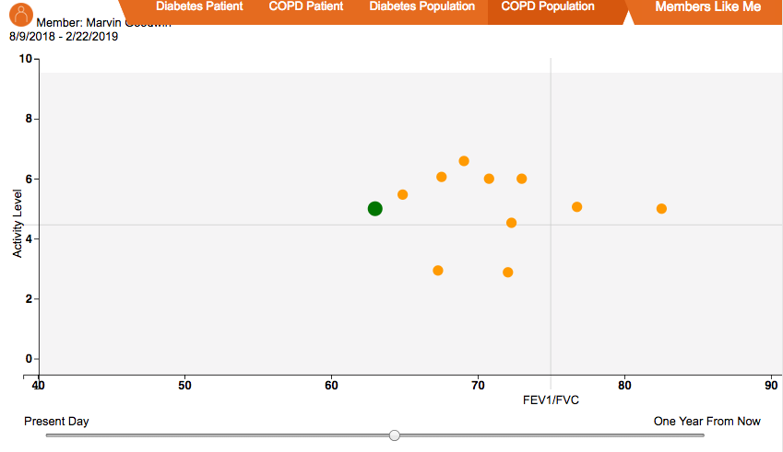
Tabular vs. Clustering with Over Time Movement
Similar Patients Table
Members Like Me Over Time
Patient ID | Jan 1 Activity Level | Jan 1FEV1/FVC | Feb 1 Activity Level
This patient | 5.5 | 62 | 5.5
Similar patient 1 | 5.7 | 70 | 5.8
Similar patient 2 | 5.2 | 75 | 6.2
Similar patient 3 | 6.2 | 80 | 5.7
Time series slider
See https://graphs.optum.com/IoT-journey.html

Slide 11
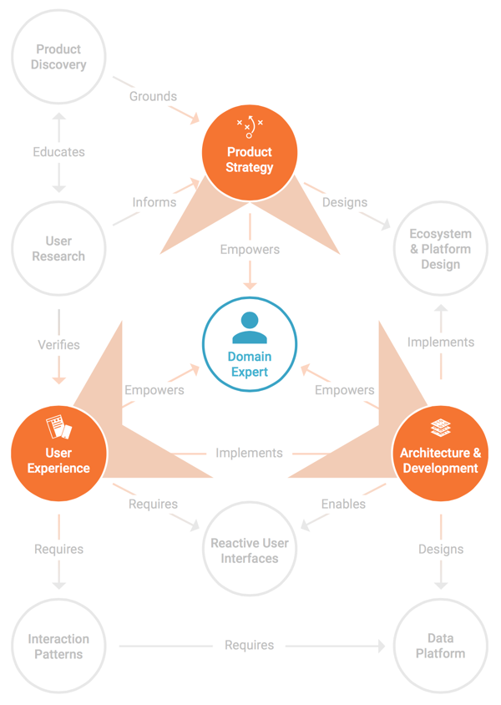
Bringing Challenging Product Ideas to Life
Data Architecture, Visualization & Training
Reactive User Interfaces
Lean Product Discovery & Rapid Prototyping
Productizing Research & Innovation Projects
Custom Software for Scientific Computing
Data Science & Machine Learning
Notes:
More and more often that means Big Data, complex data, especially Graph

Slide 12
Knowledge Domain Overlaps
User Experience
Design (UX)
Graph Models
Visualizing
Complex
Relationships
Graph Algorithms
Optum Use Cases
(clinical)

Slide 13
Topics We’ll Cover
Some basics about UX design
UX Process with Graph
State the problem
Zero in on user goals
Data discovery
Determine the best presentation
Design and prototype
Example Use Cases
Notes:
How many people are actively working on a project that involves a graph database?
How many have a project that involves presenting graph data to an end user?
We’ll briefly go over the basic concept of UX to orient everyone then we’ll jump into the UX process commonly used within the context of graph, then i’ll run through an example design exercise involving some graph data

Slide 14
Just because the data is stored in a graph…
..does not mean your users want to actually see a graph.
Highly connected data just means you have more challenges showing complex relationships and you may need different tools that traditional tabular reporting.

Slide 15
UX Basics
“User experience encompasses all aspects of the end-user's interaction with the company, its services, and its products.” Nielsen Norman Group
Notes:
UX goes beyond ui design, you have to take into account what’s going on outside of the application you’re designing

Slide 16
User Experience Design Activities
UX
Information Arch / Interaction Design
Strategy & Design Thinking
UI Design
UX Strategy & Goals
Design Decisions
Acceptance Criteria
User Goals
Information / Design Architecture
Navigation / Data Viz
Use Cases
Task Flow Design
Progressive Disclosure
Efficiency, Ease of Use
Responsive Layout / Data Entry
Component Design
Familiarity / Aesthetically Pleasing
Consistent Look and Feel
Visual Design
Notes:
Let’s look at some common UX design activities
UX design is a culmination of many cross-discipline activities, throughout the software development lifecycle.
It is a continuum and as such should maintain continuity of thought, knowledge transfer

Slide 17
UX Basics - Human Processor Model
RAM
Cache
CPU
Video Buffer
Output
Processor
Camera
Media
Processor
Mic Buffer

Slide 18
UXUX Basics - Human Processor Model Basics -
Long-Term Memory
Size: unlimited
Decay: never
Working
Memory
Size: 7 chunks
Decay (1): ~100 sec
Decay (1+): ~5-30 sec
Cognitive Processing
Cycle: ~70ms
Eye
Cycle: ~250ms
Motor Processing
Cycle: ~70 ms
Visual Image
Store
Size: ~17 letters
Decay: ~200 ms
Perceptual Processor
Cycle: ~100 ms
Auditory Store
Size: ~10 tones
Decay: 1500 ms
Source: Stuart_Card
Notes:
Well humans have “hardware limitations as well” and it turns out we’re not so good at parallel processing
Pay close attention to the transference to Working memory from cognitive processing, that’s a narrow window and it gets a lot narrower with distraction.
Motor processing also degrades, not to mention perceptive buffers, with distraction. Just imagine the loss of context if the user needed to wait 30 seconds for data to load….
Remember for later

Slide 19
UX Basics – Challenges and Solutions
Challenge | Solution
Information overload | Show meaningful information at every level, progressively disclose the rest
Ignoring environmental distractions and impediments | Know what your users do (outside your system)
Underestimating the time it takes to process information | Test, test, test
Overestimating the interest users have in using your software | Understand what your users really want to do and how they want to do it
Being lulled into complacency because your software is not designed to be “walk-up-and-use” | Assume the worst (even if it is not realistic)
Notes:
So with basic cognitive and physiological limitations in mind, let’s look at some common UX pitfalls.
This is important because everything tends to get more complex with graph data, and thus these issues become more acute.
With large, complex datasets, performance tends to be your enemy and remember the limitations we’re faced with regarding cognitive load and information processing, now put a lag in there...

Slide 20



CONGRATULATIONS! Your graph database is up and running
So now what…
Notes:
OK so now what? We’ll walk through a design process that focuses on user centered design principles and I’ll be care full to call out when special consideration is needed for graph

Slide 21
Design Process
State the Problem
Zero in on User Goals
Data Discovery
Determine the Most Effective Presentation
Prototype
Find the gap
What users think will bridge the gap
How can data bridge the gap
How do we present the bridge
Design & test assumptions
Notes:
I say this is a design process, but the team is often multi disciplinary - product team with devs and/or technical product managers
3 simple rules before you start designing everything:
know the problem
know what your users want to do,
Wait -> There is something looks a little different here
3) and understand experientially, what your data looks like (I mean really get in there and traverse it) <- this is particularly important to graph, building the beautiful wrong thing is painful
Seems simple right:
But show me an unsuccessful graph design and I’ll bet it went wrong somewhere related to one of these 3 points

Slide 22
1. State The Problem

Slide 23
Design Process - State the Problem
State the Problem
Zero in on User Goals
Data Discovery
Determine the Most Effective Presentation
Prototype
Problem statement should:
Be concise and general
Identify a major gap or deficiency in current system or process
“If I were given one hour to save the planet, I would spend 59 minutes defining the problem and one minute resolving it.”
Albert Einstein
Problem statement should not:
Contain the solution
Nest other problem statements
Address only symptoms
Notes:
First step, state the problem you are trying to solve clearly and concisely, and get all stake holders on the same page. Don’t get bogged down here treating symptoms, get to the route causes.
Stakeholder alignment <- without it, there is often a fatal flaw in the design, from the start
May have been determined but not communicated, or changed and not communicated
http://graph-viz-library-fd06ef.webflow.io/

Slide 24
2. Zero in on User Goals

Slide 25
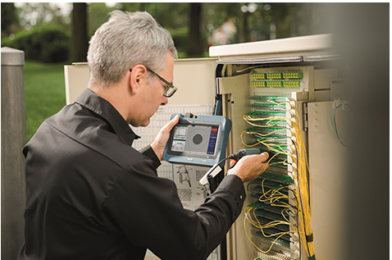
Design Process - Zero in on User Goals
State the Problem
Zero in on User Goals
Data Discovery
Determine the Most Effective Presentation
Prototype
Goals should be:
Measurable
From the perspective of each user type
Directly address the problem
Goals should not be:
Technology specific
General, vaguely subjective
Notes:
Figure out what your user want to do, document it and make it measurable.
This is going to define success and lead to increased user adoption.
This is going to anchor everything that follows to a set of validations against whom we’re actually designing our solution for,
this is user centered design
This can be something quantitative like “time to task” - “binary or % successful task completion”
We’ll come back to this guy on the right a little later

Slide 26
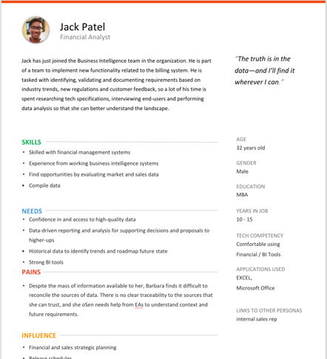
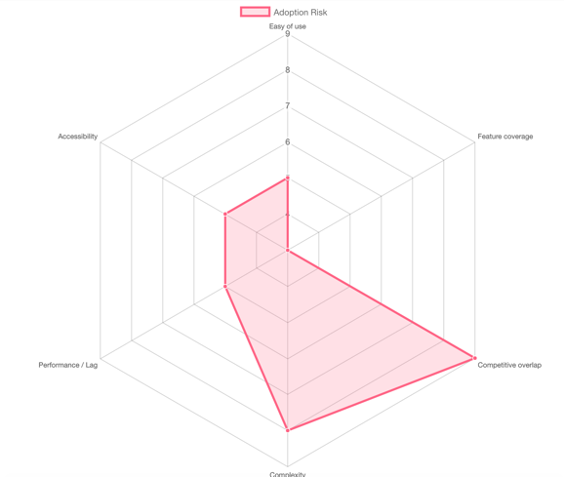
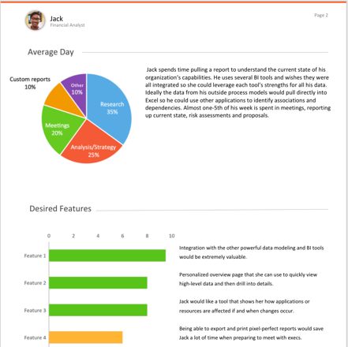
Design Process - Zero in on User Goals - Tools
State the Problem
Zero in on User Goals
Data Discovery
Determine the Most Effective Presentation
Prototype
Notes:
Tools we use for this step - data driven user research, contextual inquiry, composite score assessment on risk such as adoption
Research here on goals with actual users, talk to ppl rather than desk research, later we’ll use this baseline to validate our designs and prototypes against
This is easy to justify

Slide 27
3. Explore the Data

Slide 28
Exploring The Data - Dominant Dimensions
State the Problem
Zero in on User Goals
Data Discovery
Determine the Most Effective Presentation
Prototype
What’s the Dominant Dimension in your data?
Temporal
Frequency (Velocity)
Quality (Veracity)
Relationships (Connections, Correlations, etc.)
Context
Type (Variety)
Size (Volume)
State/Status
Georeference (Location)
Custom Attributes
Notes:
Understand the structure of your data.
Once you know what your users want to do,
zero in on the dimensions that matter, the dominant dimensions,
They define how you’ll ultimately design your software, they are the signposts of your information architecture
and a key strategy in scalability

Slide 29
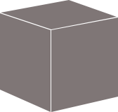
Exploring The Data - Traditional Data Storage
Filter value = Slicing: Reduce dimensionality by selecting a
single row along one dimension.
Filter range / Zoom = Dicing: Focus on a sub cube
Aggregate = Roll-up: Reduce dimensionality by summing one dimension
Detail on demand = Drill-down: Subdivide to create more dimensionality.
Field selection = Pivot: Rotate data cube
Sales
Time
Products
= Datapoint
Notes:
So classic software design usually involves some sort of data cube,
we know how to deal with this, we can slice and dimensions
to zero in on what’s important to the user.
We often don’t need to know more than the basic schema of the data, because it is relatively static.
We as UX designers, design by contract with developers, historically

Slide 30
Exploring The Data - Graph
Member
Degree
Betweenness
Shortest Path
Clustering, Communities
Similarity Dependency
B
HAS_SEEN
Member
HAS_PLAN
Provider
A
C
HAS_SEEN
HAS_PLAN
HAS_SPECIALTY
D
recommended
PLAN
E
Specialty
Notes:
Graph can be very different,
we are dealing with potentially much more dynamic data,
and the relationships between entities can get very complex,
even with a small amount of data.
****But the challenge can also be an opportunity to use new ways of presenting data to the user.

Slide 31
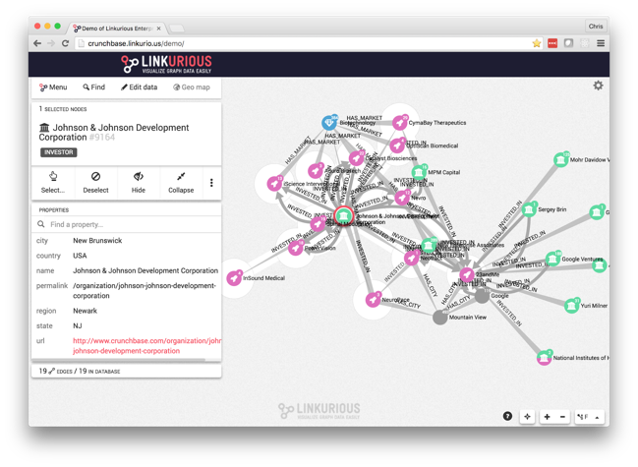
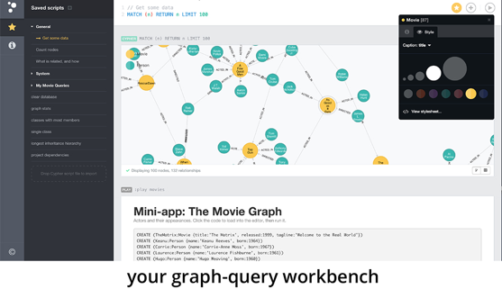
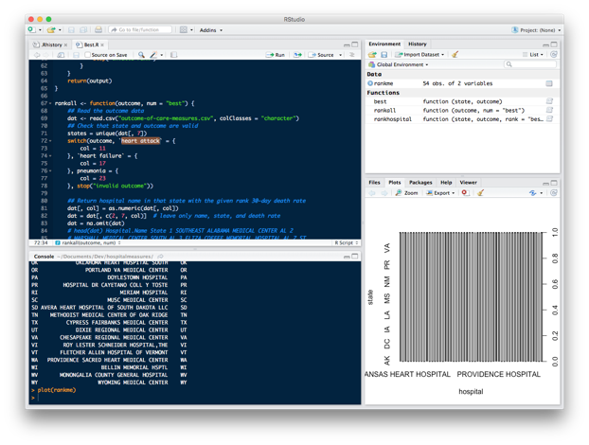
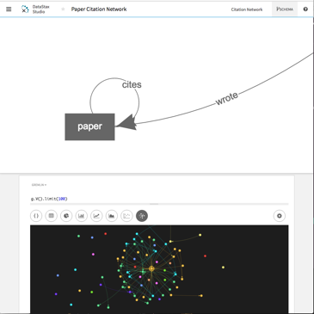
Exploring Data - Tools
Linkurious Enterprise
DB Tools
R / Python
Notes:
Stand up your data to experience it in the most expedient way possible, don’t write a ton of code if you can avoid it.
There are products like Linkurious Enterprise that do this, your database package may also have pretty powerful tools.
Demanding that a UX designer experience data in this way is a bit unorthodox but it really is a differentiator for a successful design

Slide 32
3. Determine the Most Effective
Presentation

Slide 33

Determine the best presentation
State the Problem
Zero in on User Goals
Data Discovery
Determine the Most Effective Presentation
Prototype
Graph data is complex, but how much complexity do you need to expose to the user?
Notes:
This is where UX designers tend to drive graph projects off a cliff like thelma and louise
The worst accusation is this stuff becomes an art project rather than an interactive tool
Remember when i said take note of this guy, we’ll get back to him? Well take into consideration all the things we mentioned about limitations with cognitive load, this guy is a fiber optics technician

Slide 34
Determine the best visualization
State the Problem
Zero in on User Goals
Data Discovery
Determine the Most Effective Presentation
Prototype
Answer 2 Questions:
Is my information conceptual or data-driven?
Are my visuals meant to be declarative or exploratory?
Notes:
We need to answer 2 simple questions:
Is my information conceptual (qualitative) or data-driven (quantitative)?
Am I trying to declare (prove) a known quantity or am I trying to uncover things I don’t know yet?
Your answer can be mixed, indicating a heterogeneous user experience

Slide 35
Determine the best visualization
State the Problem
Zero in on User Goals
Data Discovery
Determine the Most Effective Presentation
Prototype
Declarative
Idea Illustration
Shows process or framework
Simple metaphorical
Used to simplify complexity
Standard Data Visualization
Conventional, static
Structured, simple data
Used to affirm or set context
Conceptual
Data Driven
Idea Generation
Validate ideas
Creative, free flowing
Used to wireframe / design
Data Exploration
Trend spotting, deep analysis
Network diagram, 3D+
Used for trend spotting, deep analysis
Exploratory
Good Charts
Notes:
The answers to the questions plot the solutions into 4 quadrant
Idea Illustration think: flow diagram or org chart Idea Generation think: whiteboard or wireframes
Standard Visualization: Think Histogram or pie chart
Data Exploration, the stuff of data science, think node chart or 4d topography
One thing to note: Graph data does not always equal data exploration. Sometimes exposing your users to that much complexity is the wrong thing to do.
So let's go through these quadrants in a little more detail

Slide 36
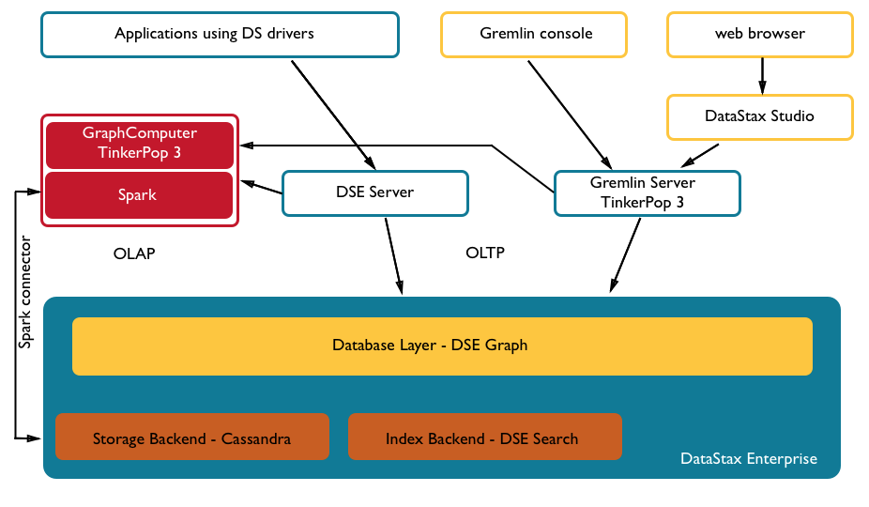
Determine the best visualization
Declarative
Idea Illustration
Shows process or framework
Simple metaphorical
Used to simplify complexity
Conceptual
Redo this based on TigerGraph/GSQL
Notes:
We need to answer 2 simple questions:
Is my information conceptual (qualitative) or data-driven (quantitative)?
Am I trying to declare (prove) a known quantity or am I trying to uncover things I don’t know yet?
Your answer can be mixed, indicating a heterogeneous user experience

Slide 37
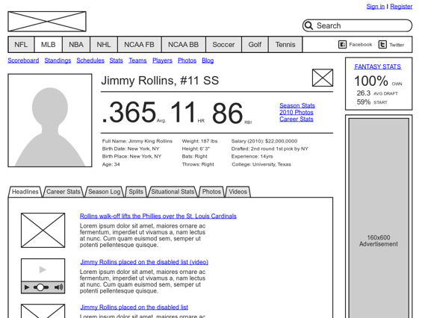
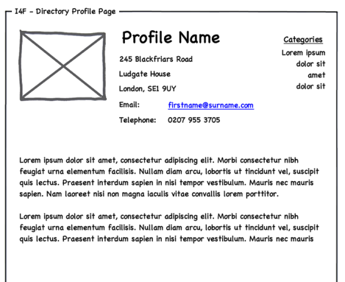
Determine the best visualization
Conceptual
Idea Generation
Validate ideas
Creative, free flowing
Used to wireframe / design
Exploratory
Notes:
We need to answer 2 simple questions:
Is my information conceptual (qualitative) or data-driven (quantitative)?
Am I trying to declare (prove) a known quantity or am I trying to uncover things I don’t know yet?
Your answer can be mixed, indicating a heterogeneous user experience

Slide 38
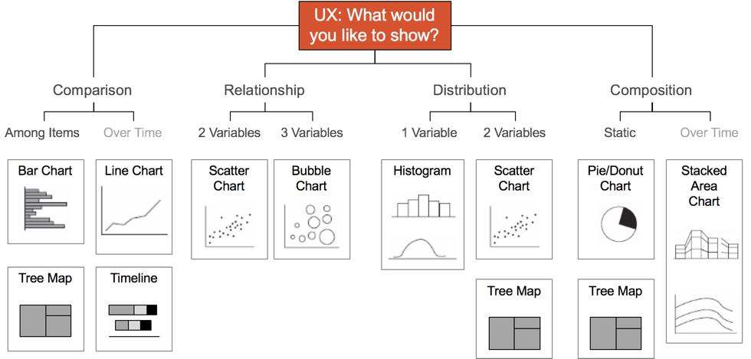
Determine the best visualization
Declarative
Standard Data Visualization
Conventional, static
Structured, simple data
Used to affirm or set context
Data Driven
Andrew Abela:
http://extremepresentation.com/
Notes:
We need to answer 2 simple questions:
Is my information conceptual (qualitative) or data-driven (quantitative)?
Am I trying to declare (prove) a known quantity or am I trying to uncover things I don’t know yet?
Your answer can be mixed, indicating a heterogeneous user experience

Slide 39
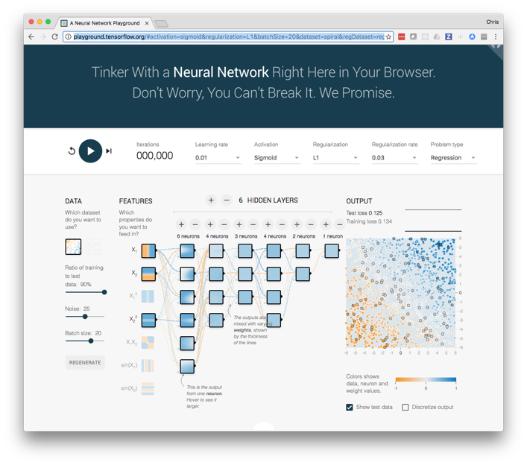
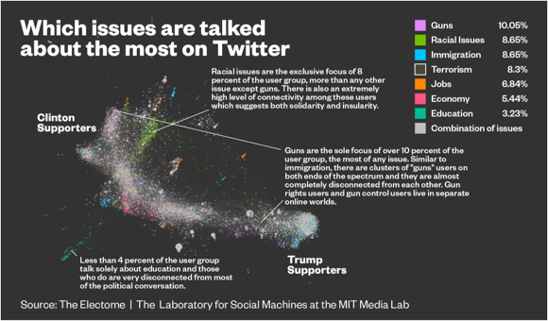
Determine the best visualization
Data Driven
Data Exploration
Trend spotting, deep analysis
Network diagram, 3D+
Used for trend spotting, deep analysis
Exploratory
Tensor Flow - neural net
Notes:
We need to answer 2 simple questions:
Is my information conceptual (qualitative) or data-driven (quantitative)?
Am I trying to declare (prove) a known quantity or am I trying to uncover things I don’t know yet?
Your answer can be mixed, indicating a heterogeneous user experience

Slide 40
Algorithm based graph stories
Dependencies
• Failure chains
• Order of operation
Clustering
Finding things closely related to each other (friends, fraud)
Similarity
Similar paths or patterns
Matching / Categorizing
Highlight variant of dependencies
Flow / Cost
Find distribution
problems, efficiencies
Centrality, Search
Which nodes are the most connected or relevant
Notes:
Graph is more complicated but some common algorithms give us hints
Look for backend process that use algorithms to give you hints on presentation
OR use presentation hints to drive algorithms

Slide 41
Shneiderman’s Mantra for Visualization and Interaction
Overview first (context and container)
Zoom and filter (component)
Details on demand
Notes:
3 basic rules for visualization interactivity, note that graph is particularly prone to information overload, interacting with a network chart is particularly tricky

Slide 42
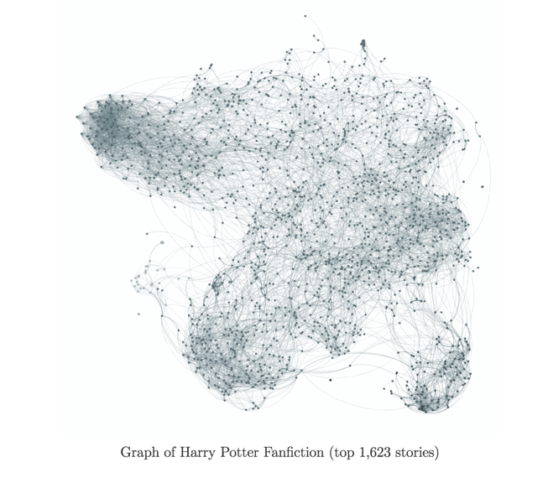
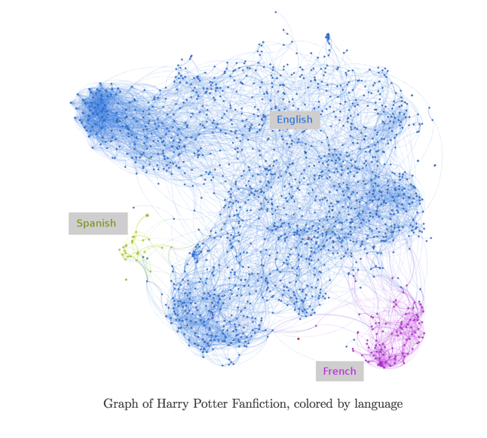

Visualization and Interaction - Overview
http://colah.github.io/posts/2014-07-FFN-Graphs-Vis/
Notes:
Let’s look at a couple of interaction antipatterns :
OVerview, even with a visualization of a large graph, exposing just one more dimension makes this overview cultured and much more usable

Slide 43
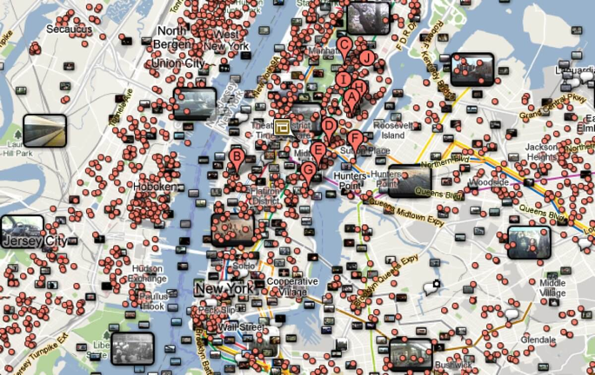
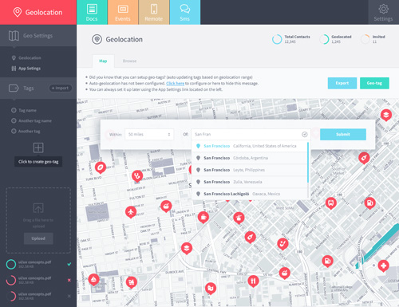
Visualization and Interaction - Zoom / Filter
http://junkcharts.typepad.com/junk_charts/2013/01/ruining-the-cake-with-too-much-icing.html
Notes:
Beware of information overload, provide default filters based on dominant dimensions, what the user is interested in. If you need to expose the graph as a network chart or geospatially - make sure it is a sub graph and add context with as much other information as possible
Need to strike the right balance between - amount of information that is useful, and scale, dominant dimensions help here

Slide 44
4. Design, Prototype, Test

Slide 45
Designs Prototypes
State the Problem
Zero in on User Goals
Data Discovery
Determine the Most Effective Presentation
Prototype
+1
+1
+1
+1
+1
-1
The right amount of functionality for a prototype:
Is there a large amount of data displayed and/or data visualization?
Are there multiple form factors targeted?
Is performance / time-to-task a key to success?
Is the technology or workflow novel to the targeted users?
Is the technology new to the application or team?
Is the time to deliver very aggressive?
No Prototyping
Lo-Fi Wireframes
Hi Fi Mockups
Semi Functional Prototype
Fully Functional Prototype
1
2
3
4
5
Notes:
Why live prototype - sometimes it is the only way to get realistic validation on big or complex data, static mockups don’t get us there all the time
complexity , size and interactivity / dynamic nature of data tips the scales

Slide 46
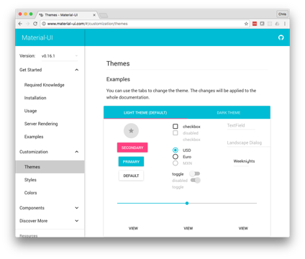
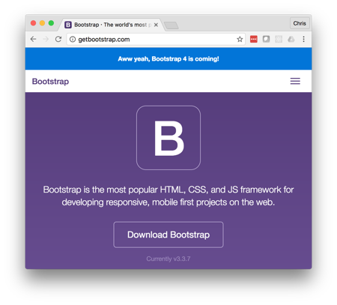

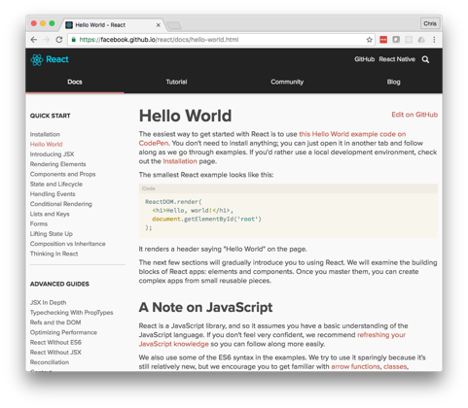
UI Frameworks and Libraries - Tools
Selecting a robust framework offers:
A better, more consistent UX
Faster development
Browser compatibility support
Responsive UI extensions
A methodology
Notes:
As far as tools go, the landscape has gotten a lot better to accelerate prototyping, especially web-based solutions
Modern UI Frameworks and libraries make things easier, faster and more cohesive
They keep your designers and developers on the rails with best practices

Slide 47
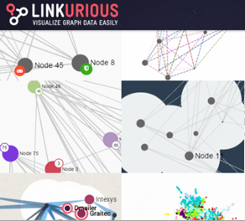
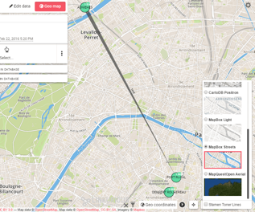
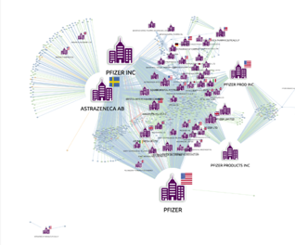
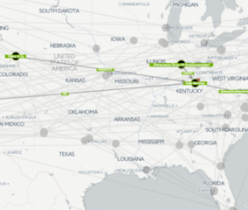
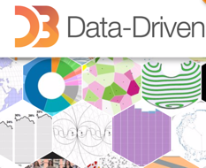

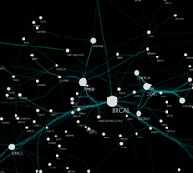
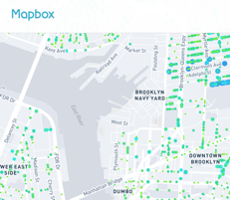
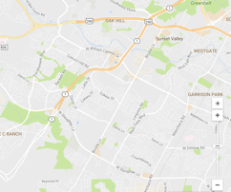
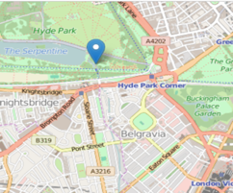
Node Chart and Geo Visualizations - Tools
Linkurious Ogma
KeyLines
D3
Sigmajs
Cytoscape
Mapbox
Google Maps
LeafletJS
Notes:
And there are graph specific tools out there...
There are tons of things out there to quickly stand up a performant, interactive node chart in a custom application

Slide 48
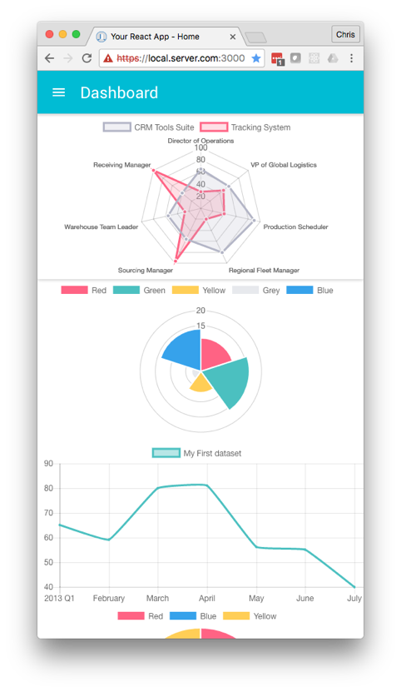
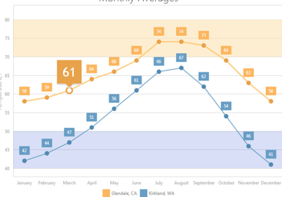
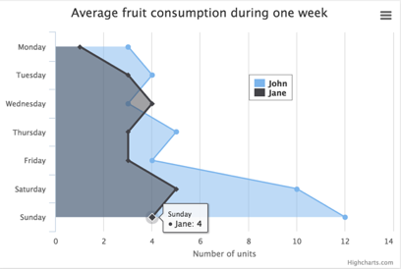
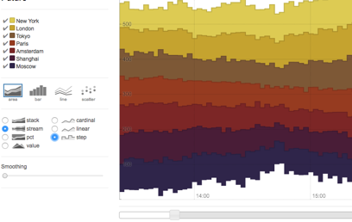
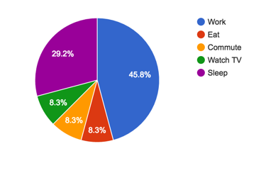
Standard Visualizations
ChartJS
Highcharts
Rickshaw
Google Charts
Notes:
A good, lightweight charting option will drop into most frameworks

Slide 49
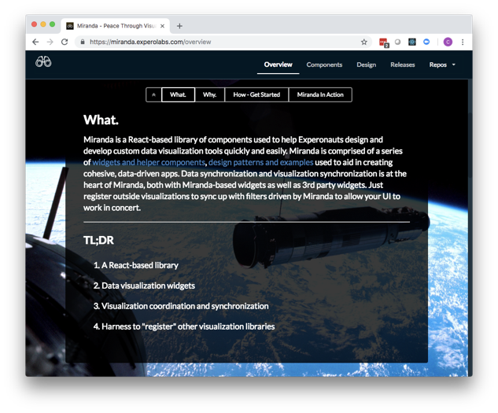
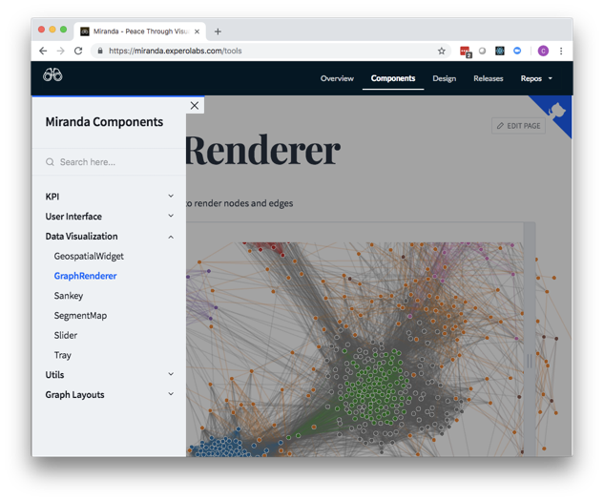
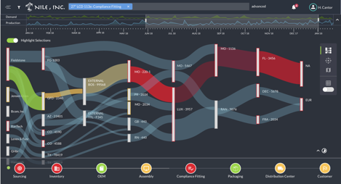
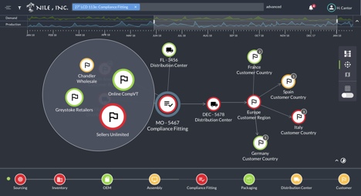
Design Systems and Connected Data
Notes:
If data is need from multiple constituencies and clear patterns emerge, creating a design system with abstract components is a solution to consider

Slide 50
Graph Use Cases Study - Example: Clinical Decision Support
State the Problem
Zero in on User Goals
Data Discovery
Determine the Most Effective Presentation
Prototype
Our users (healthcare providers) find it challenging to coordinate care for chronic diseases and comorbidities because of unclear interrelationships between treatments, providers and facilities.

Slide 51
Graph Use Cases Study - Example: Clinical Decision Support
State the Problem
Zero in on User Goals
Data Discovery
Determine the Most Effective Presentation
Prototype
Baseline Patient
‍Accurately baseline a patient by using patient’s medical history and DX results.
View clinical protocols across care plans and manage overlapping therapies.
Management of Care Plans
‍Clearly view care plans over time by disease
Progressively disclose relationships between medications prescribed
Quickly know doctors associated with each care plan
Coordinate care plans across multiple diseases and comorbidities without conflicts
Similar Patient Outcomes Comparison
‍Efficiently compare outcomes of population health data, by various demographic filters

Slide 52
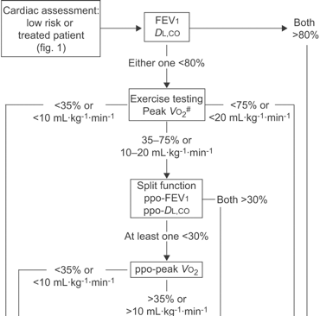
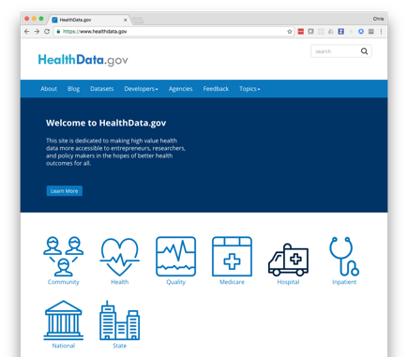
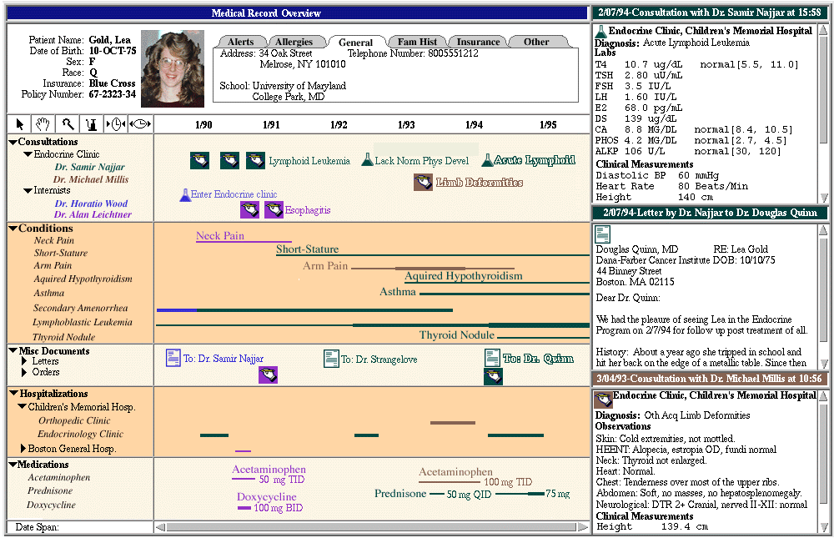
Graph Use Cases Study - Example: Medical Decision Support
State the Problem
Zero in on User Goals
Data Discovery
Determine the Most Effective Presentation
Prototype
Treatment Protocols
Population Health Data
Medical Records Data
Notes:
Treatment protocols -> expressed as graph data in our example
Population health large correlative data to give us context
Medical records data (heterogeneous format)

Slide 53

Graph Use Cases Study - Example: Medical Decision Support
State the Problem
Zero in on User Goals
Data Discovery
Determine the Most Effective Presentation
Prototype
Slice Data to Gain Insights
Dominant Dimensions
Patient
Time
Condition / Disease
Provider
Primary Entities
Event (of a care plan)
Exceptions, conflicts
Population health outcomes

Slide 54
Graph Use Cases Study - Example: Clinical Decision Support
State the Problem
Zero in on User Goals
Data Discovery
Determine the Most Effective Presentation
Prototype
Declarative
Idea Illustration
Shows process or framework
Simple metaphorical
Used to simplify complexity
Standard Data Visualization
Conventional, static
Structured, simple data
Used to affirm or set context
Conceptual
Data Driven
Idea Generation
Validate ideas
Creative, free flowing
Used to wireframe / design
Data Exploration
Trend spotting, deep analysis
Network diagram, 3D+
Used for trend spotting, deep analysis
Exploratory

Slide 55
Graph Use Cases Study - Example: Clinical Decision Support
State the Problem
Zero in on User Goals
Data Discovery
Determine the Most Effective Presentation
Prototype
Idea Illustration | View care plan events over time | Subway map
Standard Visualization | View care plan events over time (frequency) | Calendar heatmap, data tables
Idea Illustration | View treatment protocol by disease state | Flow diagram
Standard Visualization | Population Health data (trends) | Line charts, data tables
Notes:
We identify a few visualization types we want to present in the data

Slide 56
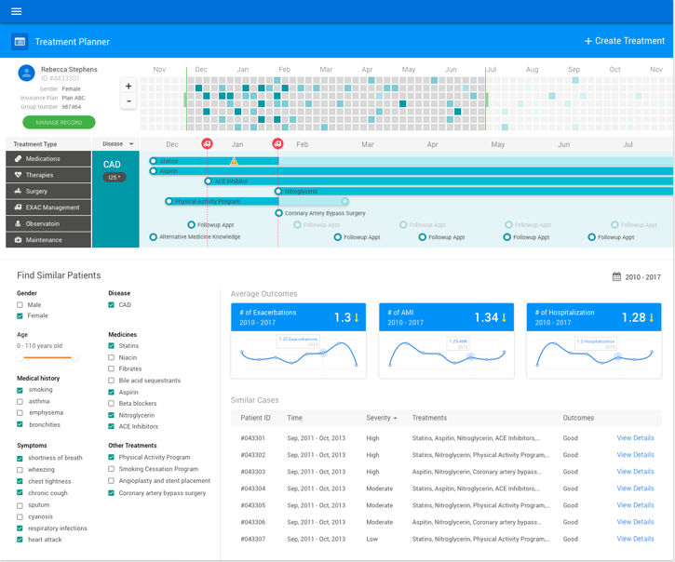
Graph Use Cases Study - Example: Clinical Decision Support
State the Problem
Zero in on User Goals
Data Discovery
Determine the Most Effective Presentation
Prototype
Dominant Dimensions
Patient
Time
Condition / Disease
Provider
Notes:
Here is our dominate dimensions, notice it dictates our information flow, architecture, real estate

Slide 57
Graph Use Cases Study - Example: Medical Decision Support
State the Problem
Zero in on User Goals
Data Discovery
Determine the Most Effective Presentation
Prototype
Primary Entities
Event (of a care plan)
Exceptions, conflicts
Population Health outcomes
Notes:
Here are our primary entities, they are the signposts that our users will want to see at a glance and drill into for more information

Slide 58
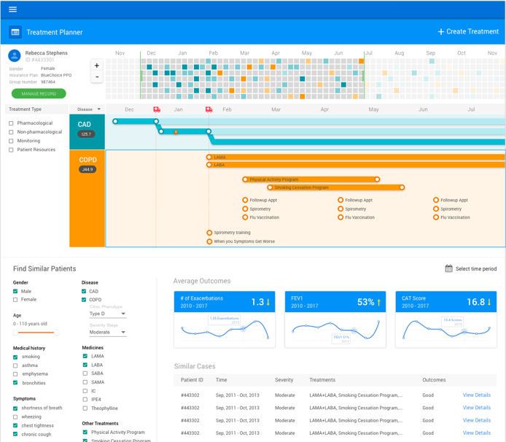
Graph Use Cases Study - Example: Medical Decision Support
State the Problem
Zero in on User Goals
Data Discovery
Determine the Most Effective Presentation
Prototype
User Goals:
Management of Care Plans
‍Clearly view care plans over time by disease
Progressively disclose relationships between medications prescribed
Quickly know doctors associated with each care plan
Coordinate care plans across multiple diseases and comorbidities without conflicts
Notes:
Let’s take a look how our design measures up against

Slide 59
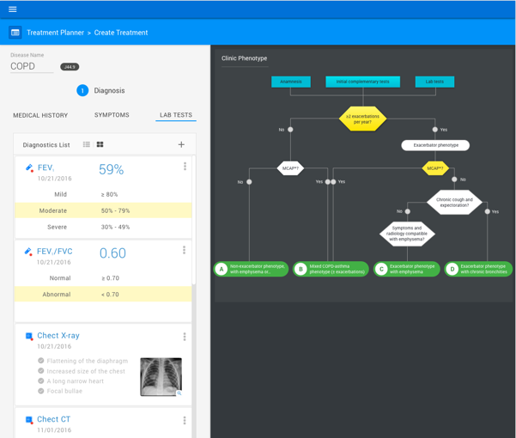
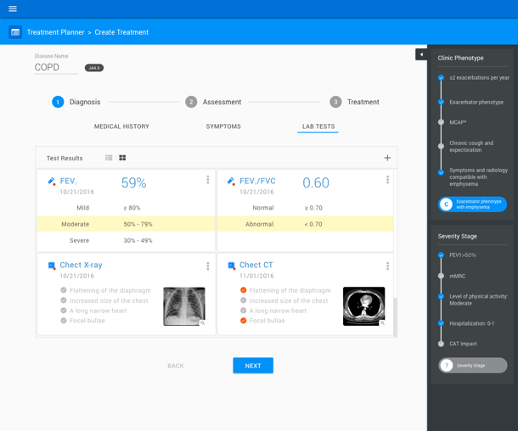
Graph Use Cases Study - Example: Medical Decision Support
State the Problem
Zero in on User Goals
Data Discovery
Determine the Most Effective Presentation
Prototype
Treatment protocols
Notes:
We expose the graph data, but in a very contextual way

Slide 60
Summary
Data is driving innovation and insights
Clinical data is some of the most complex and highly connected data at Optum
More data, more connections between data
More tools to connect data
To be competitive, we need world-class UX designers to work on our graph projects
Notes:
Excepteur sint occaecat cupidatat non proident, sunt in culpa qui officia deserunt mollit anim id est laborum.
This is my text bullet number one
Here is text bullet number two
And now we move on to text bullet number three

Slide 61
Local Optum Resources
Alex Romano – ATC (D3, force-directed graphs)
Tom Foo – ATC (D3, force-directed graphs)
Andrew Han - ATC
Dan Barkus (ATC, D3)
Manik Arora (PEDS, Member journey)
Adam Russel (OptumLabs, Natural Networks)
Andrew Plew (Force-directed graphs)

